Slide 2
Azure Services Every .NET Developer Needs to Know
Angelos Petropoulos Tim Heuer

Slide 3

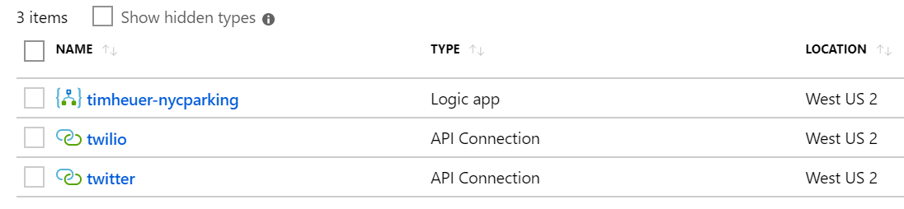
Azure – A primer
Accounts/Subscriptions
credentials and billing plans
Resource
Any service created in Azure
Resource Groups
all services placed in a group
Hosting
you provide the code, Azure runs it
Service
you provide the data, Azure takes action on the data

Slide 4
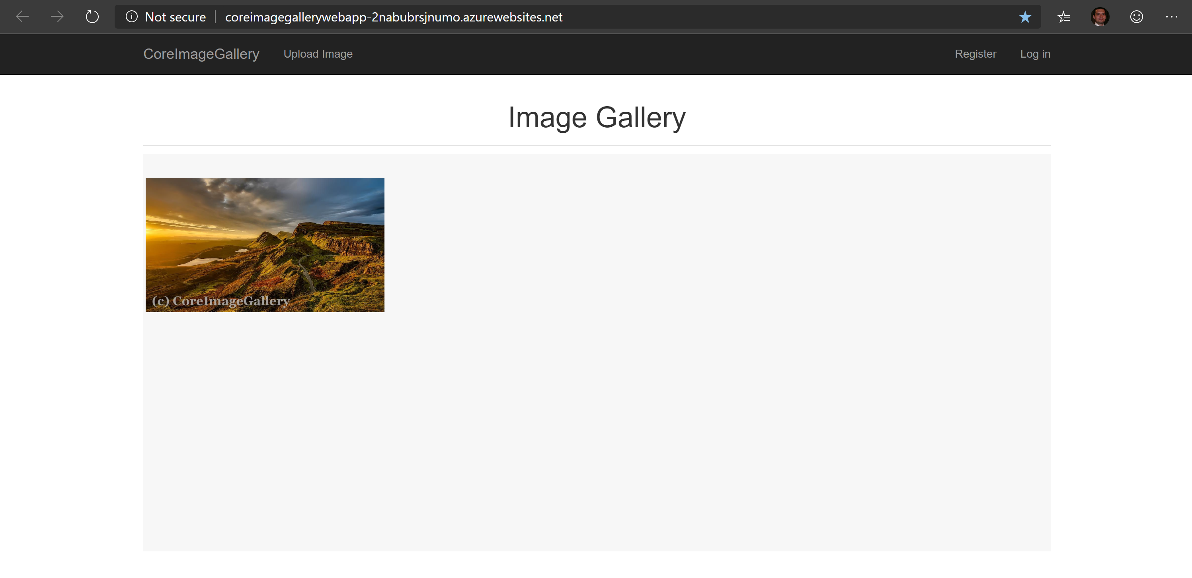

Slide 5
DEMO: Hosting & Data in Azure

Slide 6
(1) App Service and (2) Azure SQL
App Service
Web/mobile/API/logic. Great for web apps and web APIs
Fully managed: OS update, high availability/scale
Diagnostic and monitor integration
Deployment slots
First-class tooling across Visual Studio and DevOps
Azure SQL
Same as SQL Server! (updates sooner than SQL Server)
Fully managed: patching, high availability/scale
Extensive monitoring/alerting
Integration with Visual Studio

Slide 7
DEMO: Update Storage Manipulate Image

Slide 8
(3) Azure Storage (Blobs)
Managed, scalable, and secure data storage
Blobs – objects/files/’stuff’
Tables – noSQL, key/value data
Queues – messages and work items
Files – mountable file shares
Automatically replicated and backed up
Optional geo-relocation redundancy

Slide 9
(4) Azure Functions
Serverless
Never create or manage VMs or clusters
Auto-scales automatically
Event-driven
Executes on ‘events’ like HTTP, Queues, Timers, Storage, etc.
Great for simple jobs and workers
Cost-effective
Consumption-based billing

Slide 10
DEMO: Monitoring

Slide 11
(5) Azure Monitoring / App Insights
Built-in monitoring/diagnostics for failures and perf
Rich diagnostic data to root cause issues
Collect metrics, logs, requests, dependencies, correlation IDs
Distributed tracing
Snapshot debugging in production Profiler for performance issues

Slide 12
5 Key Azure Services
App Service
Scalable, managed hosting
Azure SQL
Secure, managed relational data
Blob storage
Durable object storage integrated with services
Serverless
Fast, cost-effective, auto-scale functions
Monitoring/App Insights
Gain insight and diagnostics to continually tune

Slide 13
And more…!
Hosting
Azure Kubernetes Service (AKS) – container orchestration
Azure Service Fabric – mesh for distributed microservices
App Service Linux
Services
Key Vault – store secrets and retrieve using managed service identities (MSI) or certificates
Service Bus – sophisticated queues, routing
SQL Managed Instance – dedicated, lift-and-shift
Azure Cosmos DB – Modern noSQL database for cloud
Azure Active Directory – AD for the cloud, B2B, B2C

Slide 14
Resources
https://dot.net
Get the tools and SDKs to be productive
https://aka.ms/dotnetazuredev
Get started with learning resources and tutorials
https://azure.com/free
Get started with a free subscription
If VS Subscription, you have Azure credits

Slide 15
Thank you!

